Slide 1
From Vancouver to Toronto
Moving a company

Slide 2
Objective
Our company is opening a new office in Toronto to be closer to the east coast and Europe.
We have been tasked with finding a similarly dynamic and young neighborhood as the one we are currently located in to minimize the difference that some young workers will feel in the move.

Slide 3
Data
We will use Foursquare to look at our current neighborhood and then use k-means clustering to identify neighborhoods in the Toronto area that are similar.
We will then clean up the data and re-cluster to narrow the search down to just a few options

Slide 4
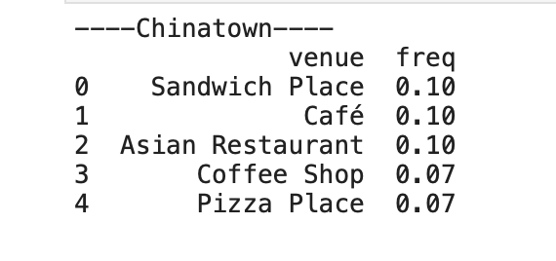
Categorizing the Data
The first task was to characterize the neighborhood we are in.
Chinatown is a dynamic, young, and trendy neighborhood know for its great social scene and food.
Using Foursquare, we created a profile of the neighborhood based on the available venues.

Slide 5
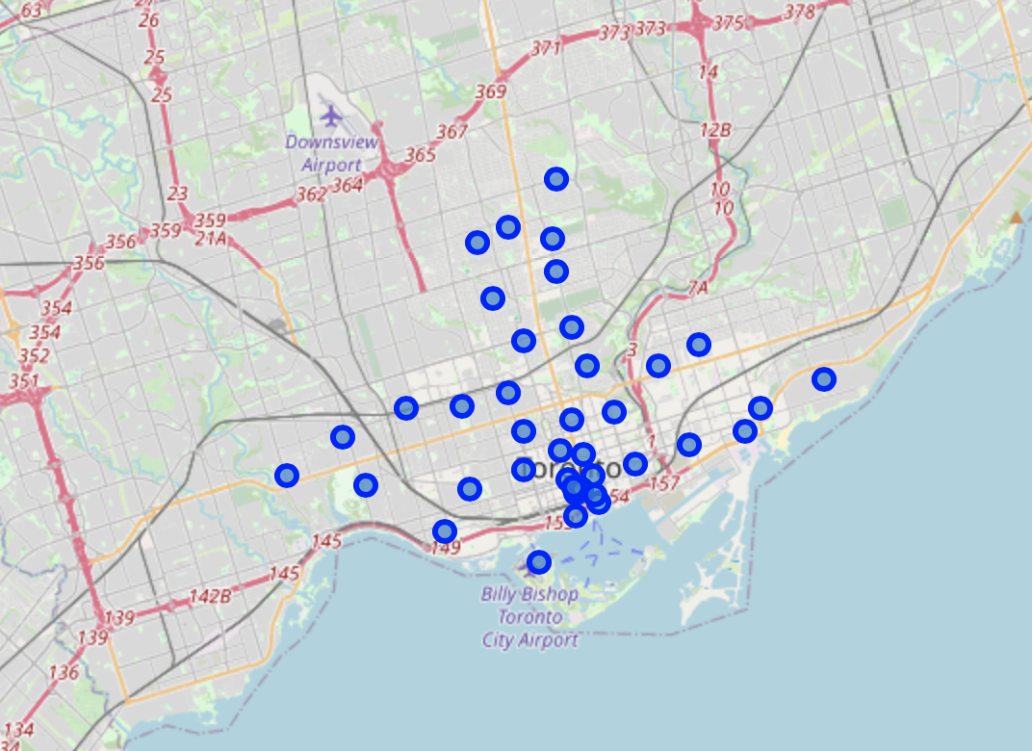
Toronto
With this data, we then went and created similar profiles for every neighborhood in Toronto.
Each blue dot below represents a neighborhood in Toronto
The next step was to cluster all the Toronto data with the inclusion of our part of Vancouver

Slide 6
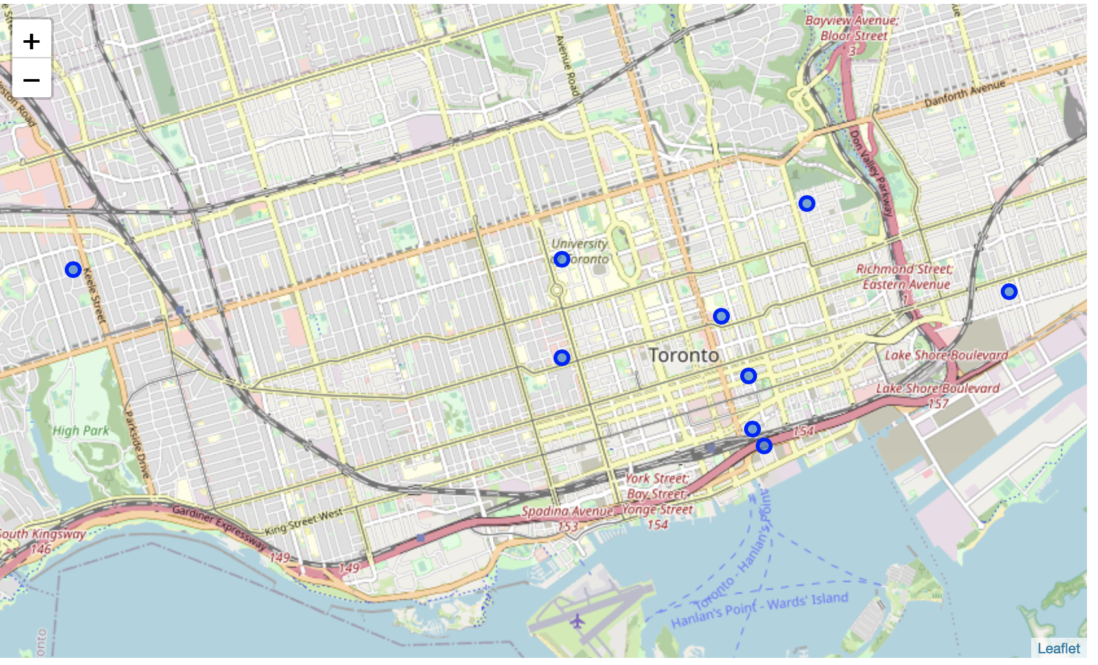
Initial Results
The first clustering produced too many options.
This could have been due to several factors, such as stark venue differences (i.e. Airport, parks, stadiums, CN Tower, etc.
The next step we took was to clean up the data and re-cluster with just the “candidates”

Slide 7
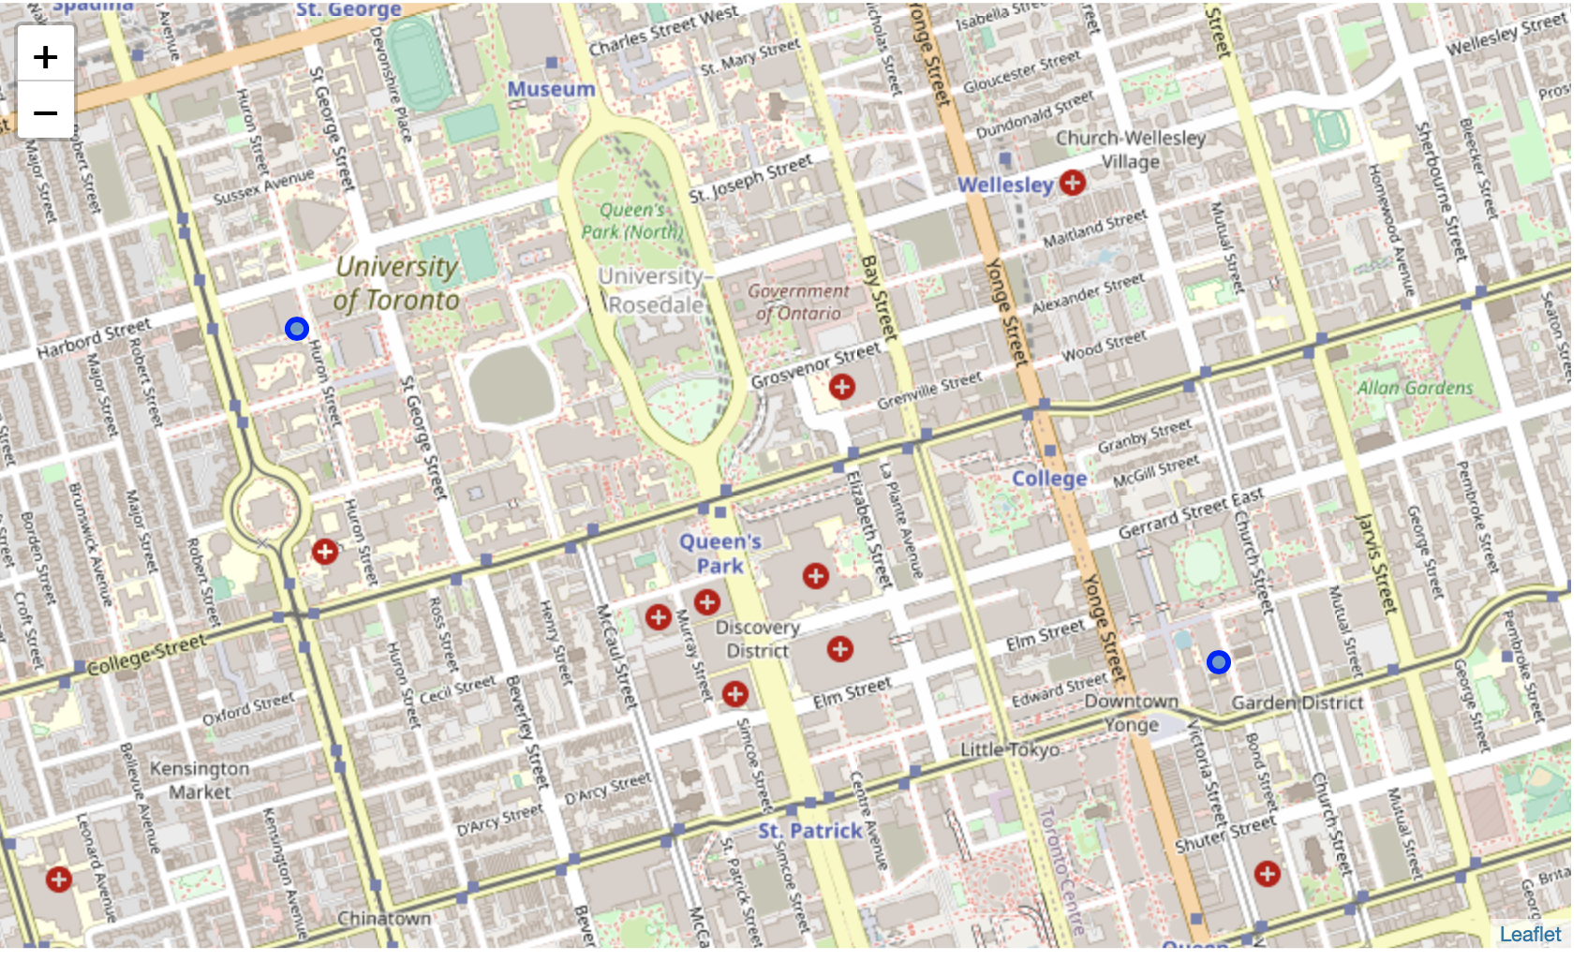
Final Results
After re-clustering we were left with just two final options, both of which happen to be in Downtown Toronto.
Either the Garden District or Harbord would be good selections for the Toronto Headquarters.

Slide 8
What’s missing?
While this clustering did help to narrow down the choice. There are some short comings to consider:
It is only based on what is in Foursquare, which misses a lot of the actual venues in the area
It does not consider corporate space or living space options
It is however a good and quick way to decide which areas MAY be good matches.

